Slide 1
Cyclistic Bike-Share Analysis
Insights into Usage Patterns of Casual Riders and Annual Members
Samuel Adebayo, Junior Data Analyst
16th June 2024

Slide 2

INTRODUCTION
Brief overview of Cyclistic and its bike-share program in Chicago.
Explanation of the analysis objectives.

Slide 3
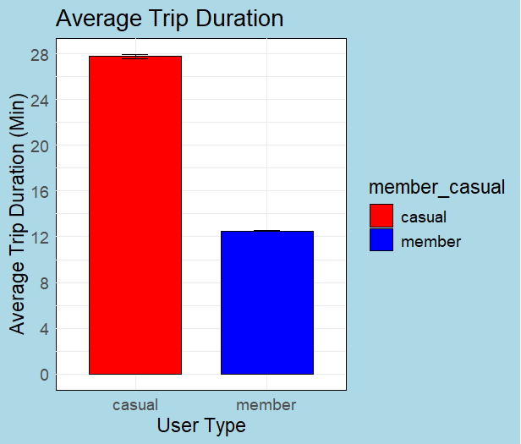
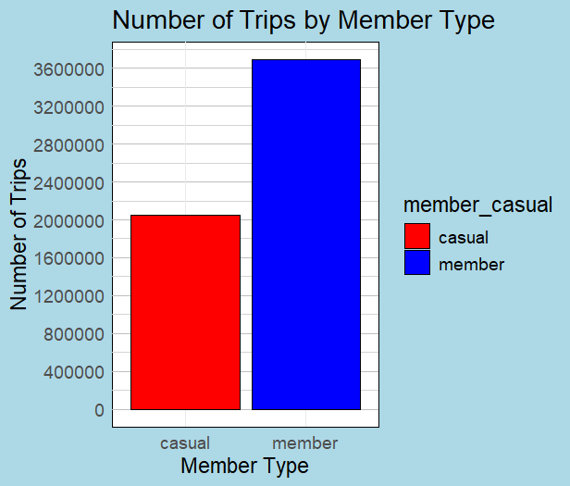
AVERAGE AND COUNT Of trips
Casual riders have higher Average than Annual members but make a lesser amount of trips.

Slide 4
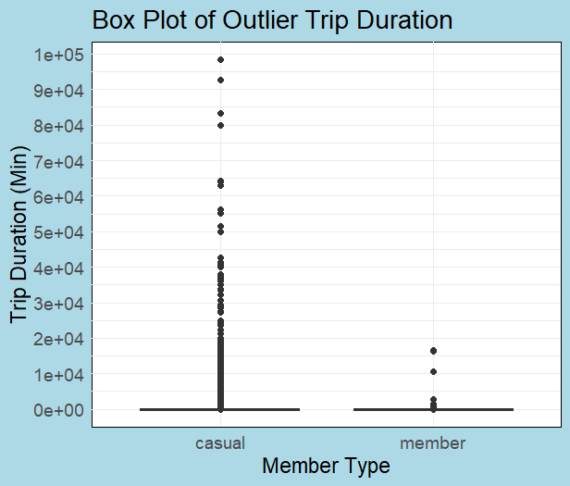
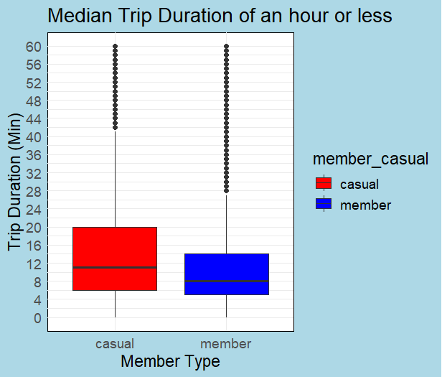
MEDIAN AND OUTLIERS
Higher amount of outliers for casual riders
Median of casual rider is higher than annual member as seen in Average.

Slide 5
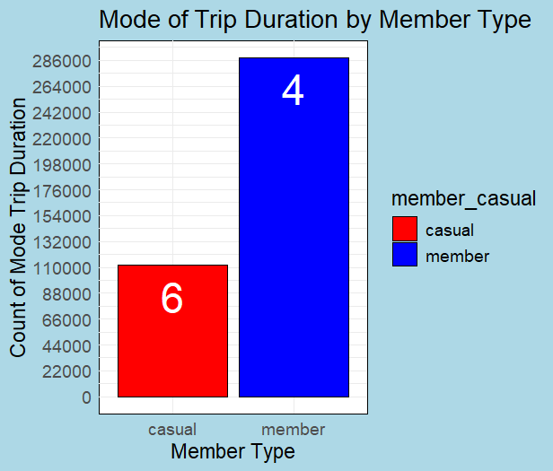
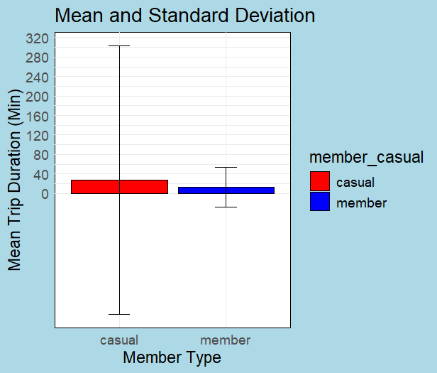
MODE AND STANDARD DEVIATION
There are more members with a trip time of 4 minutes, while the casual riders, though have a lesser count, spend more time.
Casual riders also have a larger standard deviation, indicating more variability in trip durations.

Slide 6
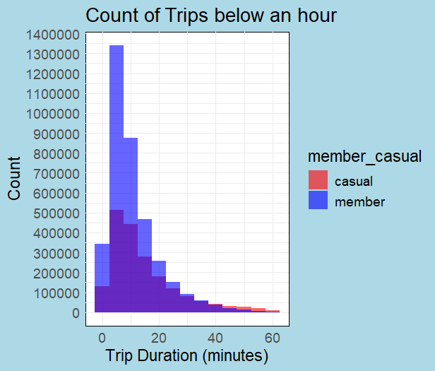
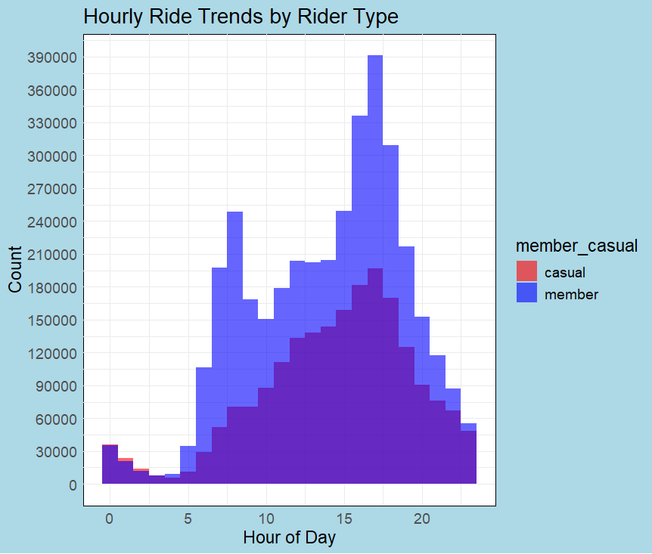
Hourly Ride Trend
Casual riders peak in the late morning and afternoon.
Annual members have a distinct peak during commute hours (7-9 AM and 5-7 PM).
Most riders ride for about 5 to 20 minutes

Slide 7
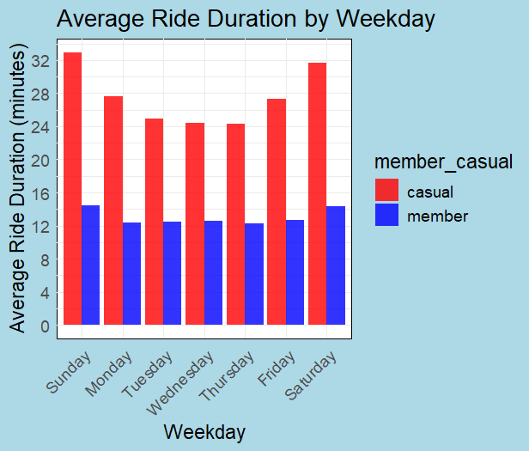
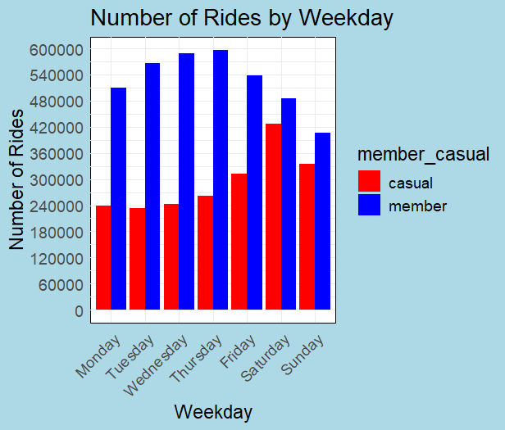
WEEKLY ANALYSIS
Casual riders have higher average usage on weekends.
Annual members have consistent usage throughout the week with a slight peak on weekdays.
Casual riders count peak at the middle of the week.
Annual members peak during the weekends.

Slide 8
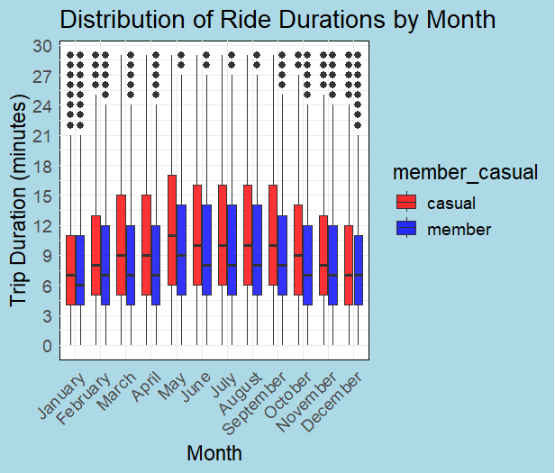
RIDE DURATIONS
Ride trends show seasonal variation, peaking in summer months.
Both casual riders and annual members follow similar seasonal patterns, but casual rider usage is more variable.

Slide 9
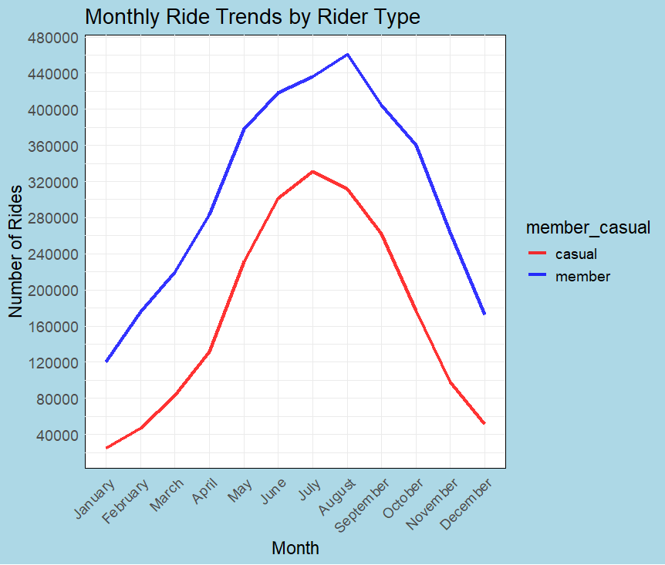
Monthly Ride Trend
Ride trends show seasonal variation, peaking in summer months.
Both casual riders and annual members follow similar seasonal patterns, but casual rider usage is more variable.

Slide 10
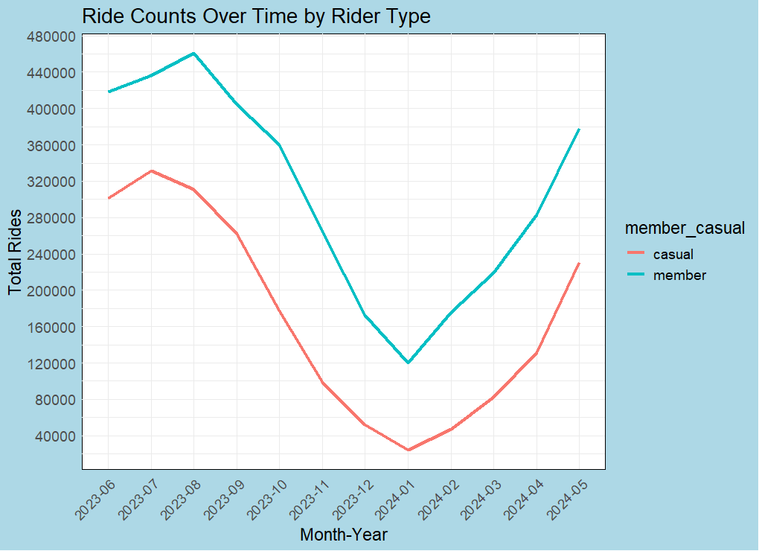
ANNUAL TRIPS
Seasonal Trends: Higher usage in warmer months; dip in winter.
Recovery: Ride counts start to recover in early spring.
Casual Riders: Greater decline in winter, indicating weather sensitivity.
Members: More stable usage year-round, consistently higher than casual riders.

Slide 11
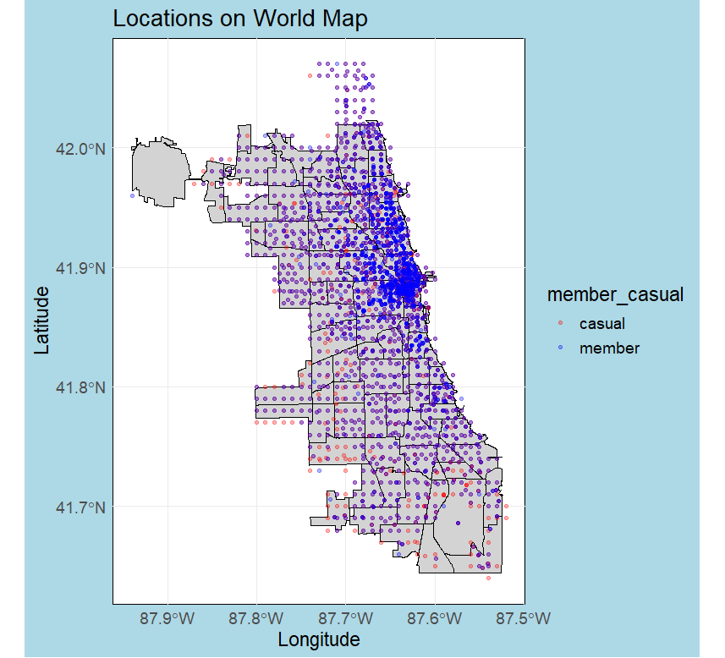
Geographic Analysis
Visualization of ride start locations within Chicago.
Differences in popular locations for casual riders and annual members.

Slide 12

Key Insights and Recommendations
Promotional Offers:
Seasonal and trial memberships
Marketing Campaigns:
Commute incentives and leisure benefits
Digital Strategy:
Targeted ads and engaging content
Service Improvements:
Enhance top stations, exclusive member perks
Community and Events:
Member-exclusive events and local partnerships

Slide 13
Conclusion
Ride Patterns:
Casual riders: Fewer, longer rides (~28 mins)
Annual members: More frequent, shorter rides (~12 mins)
Peak Times:
Casual: Afternoon peaks, variable weekends
Members: Morning/evening peaks, weekday commutes
Seasonal Trends:
Peaks in summer, dips in winter
Casual riders show more seasonal variation
Geographical Distribution:
Members: Concentrated routes
Casual: Dispersed routes
Top Stations:
Identified top 10 start stations

Slide 14

Questions & Discussion

Slide 15
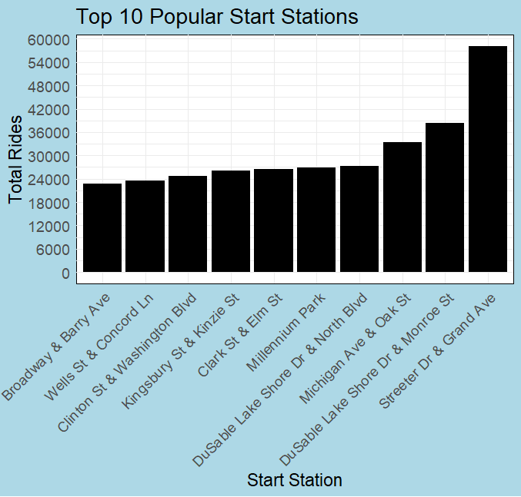
APPENDIX

